Slide 1

Global Covid-19 Vaccination Data Analysis and Visualization
BY Srishti Arya

Slide 2
Agenda
To analyze and visualize the nature of pandemic and its steps for vaccination around the world by using charts.
The below charts will depict:
Vaccination rates among different countries.
The Vaccination effects on hospital admissions.
The rate at which vaccination was taken among different age groups
Ranking of countries exceeding in taking vaccines.
The different vaccines administered in a country.

Slide 3
About Our Data
The data was collected from our world in data.
The data was selected on the basis of interests and the generate more insights from it.
The scope was taken into consideration as more useful variables and insightful data was found.
Our data consists of 68 columns to choose from.
We took references for our visualization from Our world data and Nytimes.

Slide 4
At a glance
After completing a year of lockdown, we finally started vaccination drive in various countries.
There were various vaccines produced by Scientists and trials were taken into consideration depending on scenarios.
The goal of any vaccine was to keep away from the severe sickness or being hospitalized.
At least one dose of the COVID-19 vaccine has been given to 55.4 percent of the world's population.
Globally, 8.32 billion doses have been administered, with 32.26 million doses being administered every day.

Slide 5
Visualizations

Slide 6
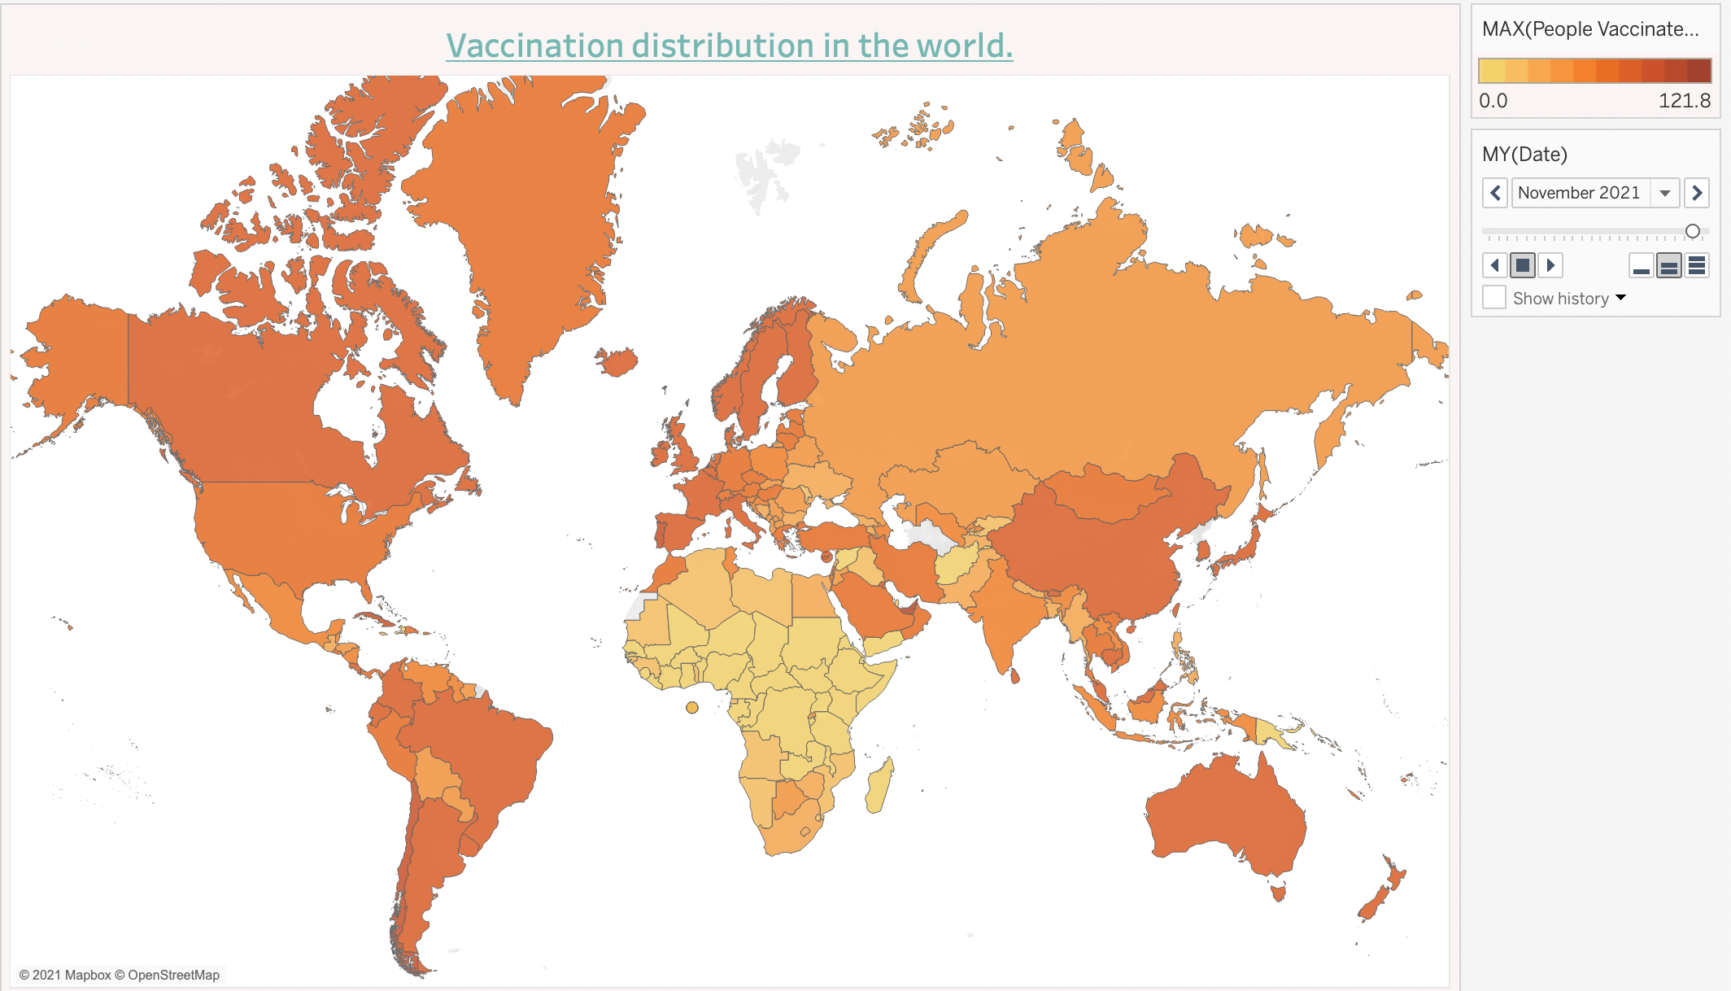
Covid Vaccines doses administered in each country

Slide 7
About the world vaccines administered
In our analysis of vaccination rates by country, we found that several countries have made great progress in their vaccination drives.
Notable countries with high vaccination rates per hundred include the USA, Canada, China, Spain, Denmark, and other European countries.
However, our analysis also revealed a concerning trend in African countries, where vaccination rates per hundred are significantly lower than in other regions.
Specifically, the average number of people vaccinated per hundred in Africa is 11.91, which is well below the global average and a cause of concern.
This finding underscores the need for increased attention and resources to ensure that vaccines are more widely distributed and accessible in African countries.
Visualization: Include a world map that visually represents the vaccination rates per hundred in different countries. Highlight the countries with the highest and lowest vaccination rates.

Slide 8
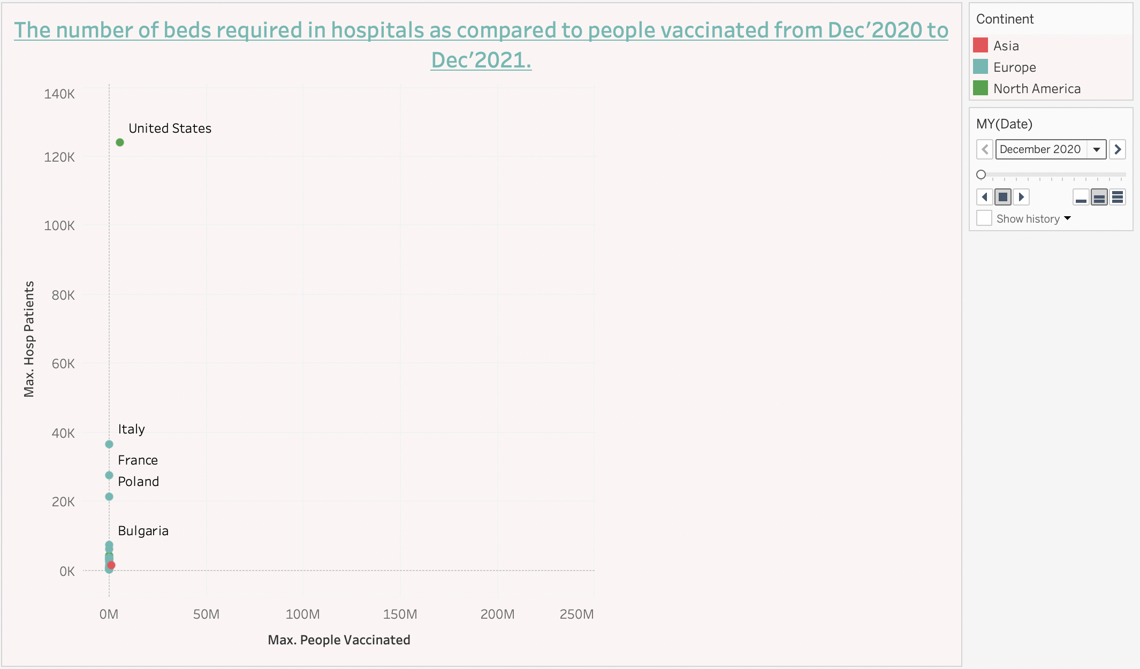
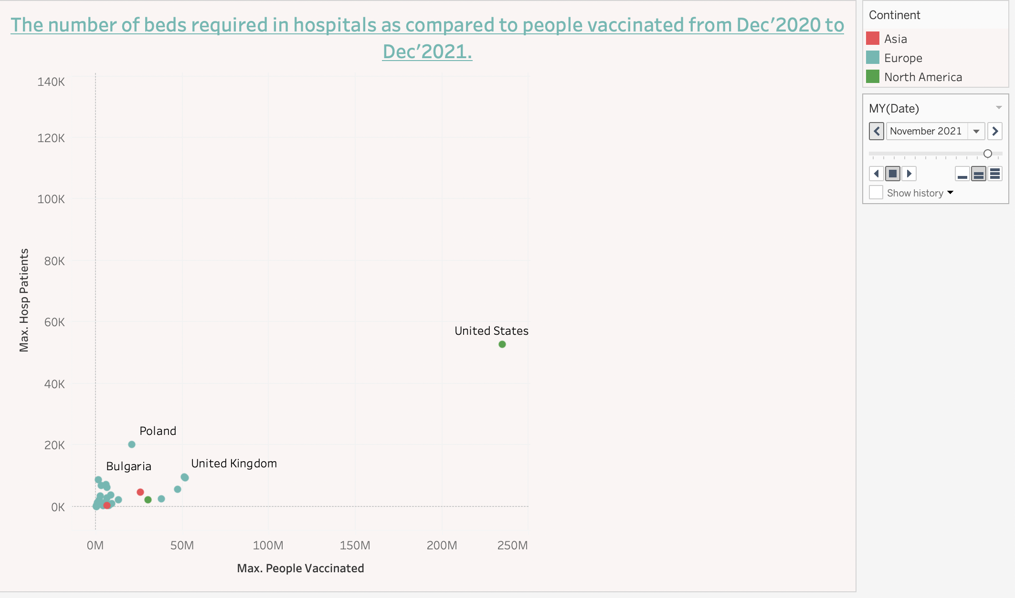
A Comparison of Hospitalization Rates Before and After Vaccination

Slide 9
Insights
Introduction: The success of COVID-19 vaccination can be measured in many ways, one of which is the impact on hospital admissions. In this slide, we present two charts that showcase the impact of vaccination on hospitalization rates in the US and Spain.
Chart 1: The first chart displays the number of hospitalized patients and people vaccinated in December 2020. It shows that the US had the highest number of hospitalized patients (123,921) compared to other countries.
Chart 2: The second chart shows the hospitalization rates in November 2021. We observe that the number of hospitalized patients has decreased significantly to 58,620 in the US. Similarly, in Spain, the number of hospitalized patients decreased from 30,815 in January 2021 to 2,398 in November 2021.
Conclusion: These charts demonstrate the positive impact of vaccination on reducing hospital admissions. The decrease in hospitalization rates is a testament to the efficacy of COVID-19 vaccines and highlights the importance of continuing the vaccination drive globally to reduce the burden on healthcare systems.

Slide 10
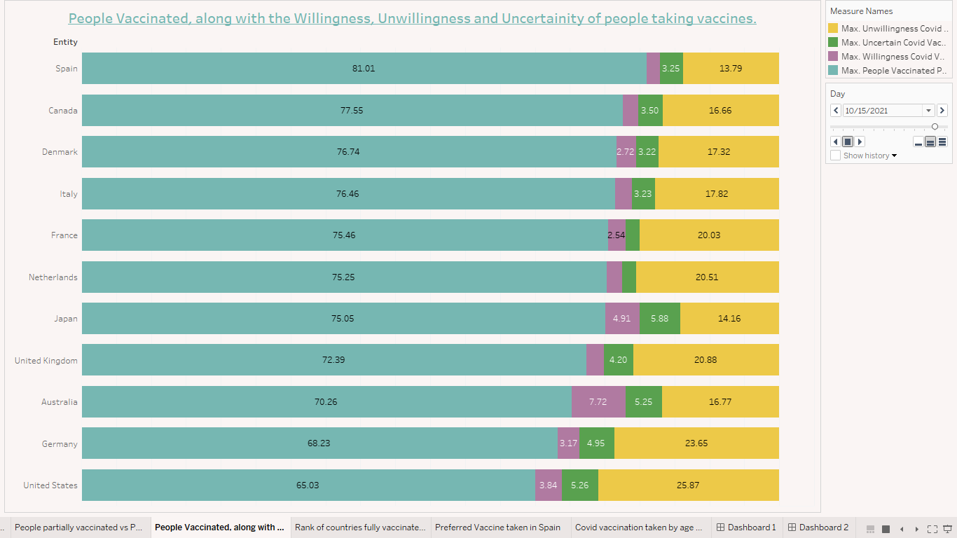
The Different Parameters used for For administration
There are 4 parameters which are considered in the following graph:
The no. of vaccinated people.
The willingness to take the vaccine.
The uncertainty of the vaccination.
The unwillingness to take the vaccine.
We selected 10 countries where we can see successful vaccination drives.
We can see that Spain has the most successful vaccination drive.

Slide 11
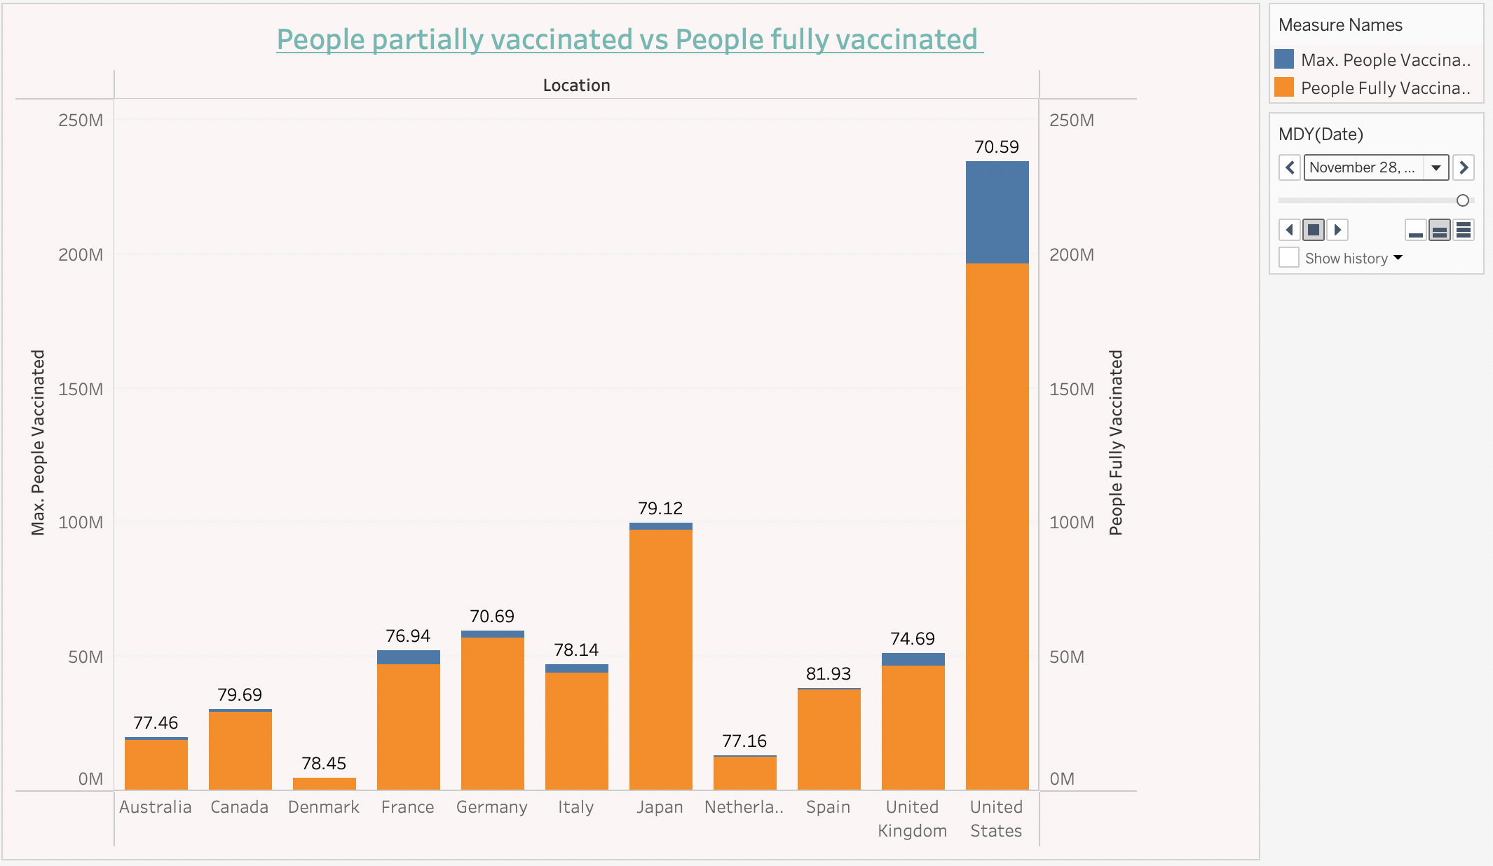
In this the stacked bar is shown to partially vaccinated and fully vaccinated.
There are 3 parameters: Partially vaccinated Fully vaccinated and vaccinated.
The vaccinated people include one and two doses both.
This graph shows the vaccination as per the population density.
USA is highly populated but only 59% is fully vaccinated.
Whereas Spain leading the fully vaccinated by 81%

Slide 12
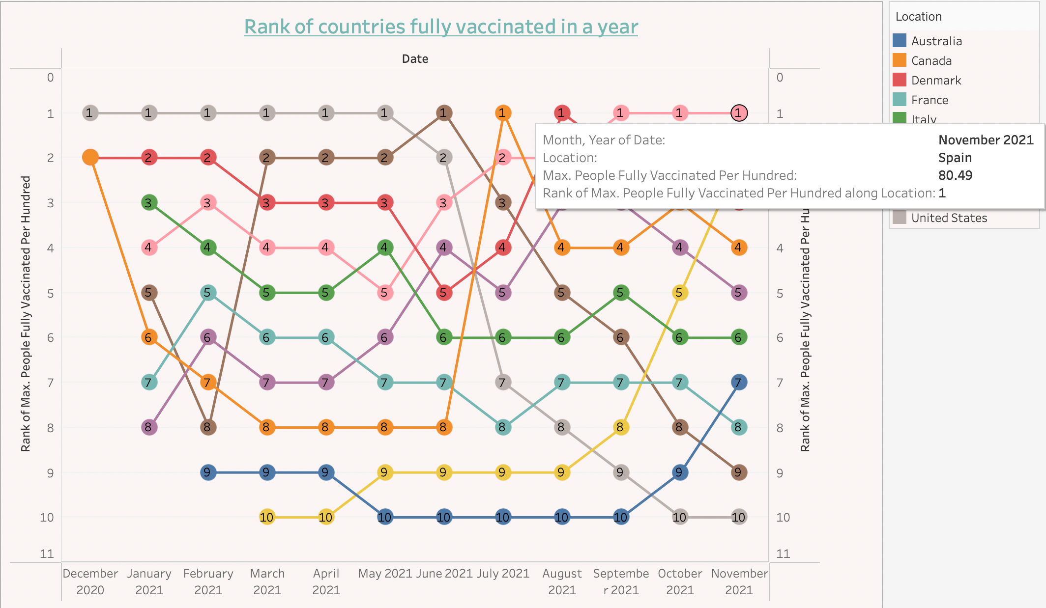
The chart depicts the percentage of the fully vaccinated population of leading countries over time. The USA initially led the distribution, but Spain has since surpassed them and now has an 80.49% fully vaccinated population.

Slide 13
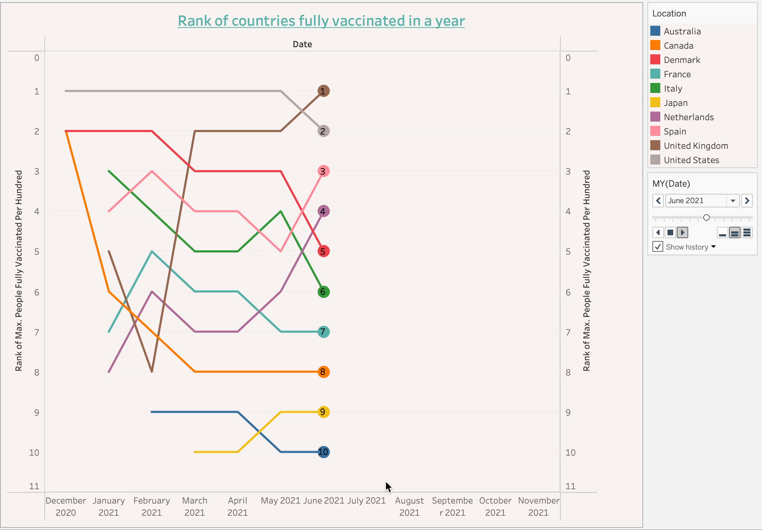

Slide 14
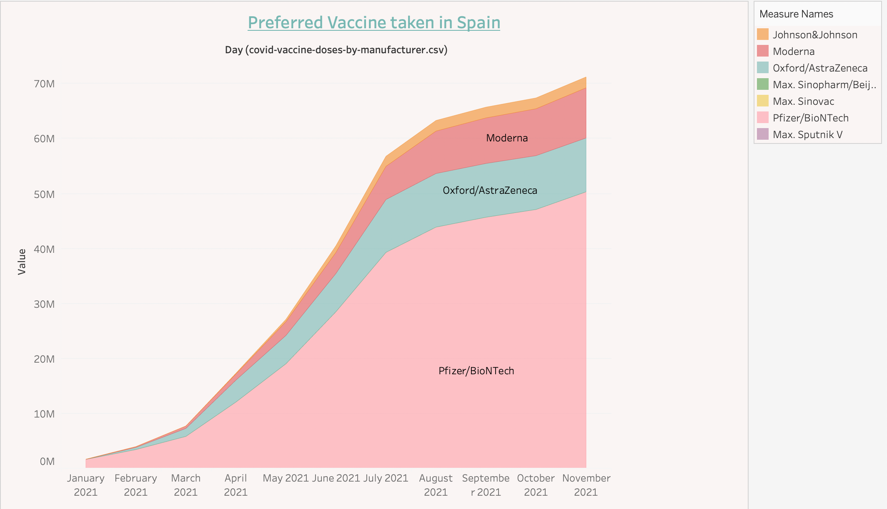
As seen previously Spain comprised of most fully vaccinated people on percentage basis.
The analysis of the chart indicates that the Pfizer vaccine was the most preferred vaccine in Spain, with a significant majority of people opting for it over other available options.
For vaccines that require multiple doses, each individual dose is counted. As the same person may receive more than one dose, the number of doses can be higher than the number of people in the population
Pfizer was one of the most trusted amongst the other vaccines followed by Oxford/AstraZeneca.
There is a marginal difference between Oxford and Moderna’s vaccination the difference been less than a few thousands.

Slide 15
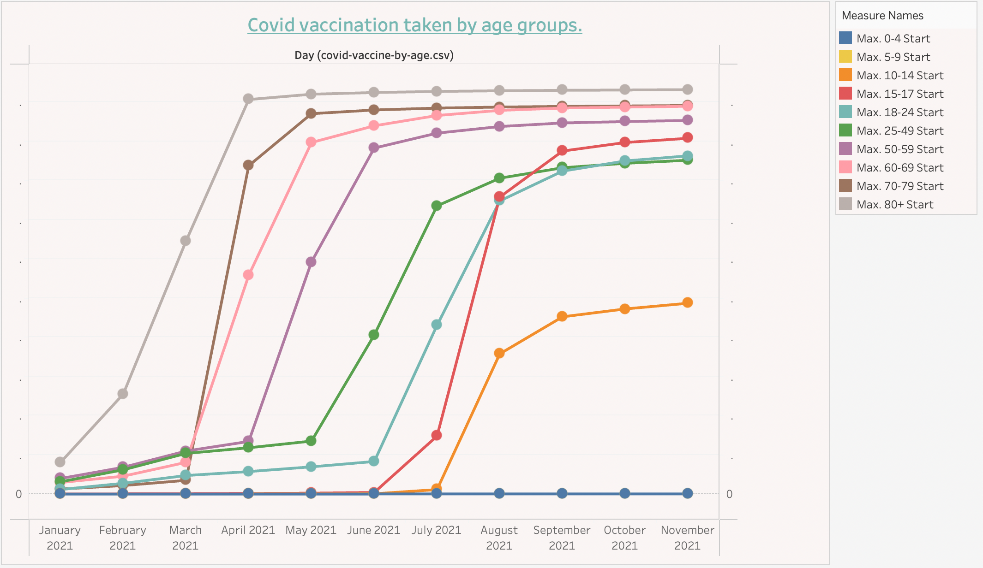
The visualization below shows Covid Vaccination taken by people on basis of age group

Slide 16
Insights
Mainly the older the age more the vaccination as the vaccination was started for the elderly and gradually for the younger ones.
We can observe that as the age decreases the vaccine administered also decreased.
This solely being the distribution of the vaccines starting for the senior citizens prioritized over others.
The younger generation is at the minimum as there was no vaccines produced for them.

Slide 17
Conclusion
The global COVID-19 vaccination drive is an essential initiative for every country to survive this pandemic. Through our analysis and visualization, we have gained valuable insights into the vaccination drive's impact on different countries and populations.
We observed that the countries with higher numbers of vaccinated people required fewer hospital beds, indicating that vaccination drives have been effective in reducing the severity of the disease and hospitalization rates.
Our analysis revealed that spreading awareness and building trust in the vaccine is essential in reducing vaccine hesitancy and increasing vaccination rates. Vaccine safety is critically important, but a determination of safety is ultimately a value judgment.
We found that people across age groups at higher risk were more inclined to take the vaccines.
Through our analysis, we found that Africa has one of the lowest vaccination rates globally, which puts the continent at a higher risk of experiencing a new wave of COVID-19 infections. The data highlights the urgent need to ramp up vaccination efforts in Africa to protect vulnerable populations and prevent the spread of the virus.

Slide 18
Thank you!

